Slide 1
Investment Information Feed System
iif system

Slide 2
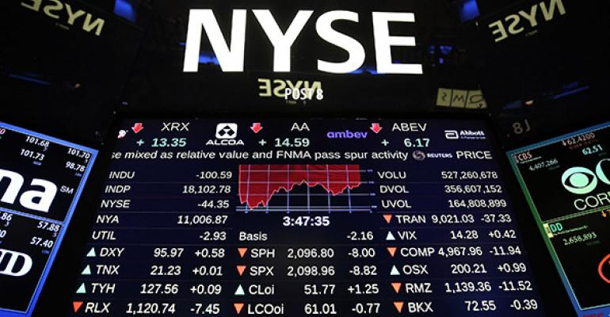
Objectives
Provide prevailing financial information to the customers and RMs
Expedite analyzing process carried out by the RMs, and accelerate information access by and disclosure to the customers as well as the RMs
Facilitate security transactions, and thus rally the earned Brokerage, Custody Fee, Subscription for New Issues
(Shanghai and Shenzhen Connect & US Listed)

Slide 3
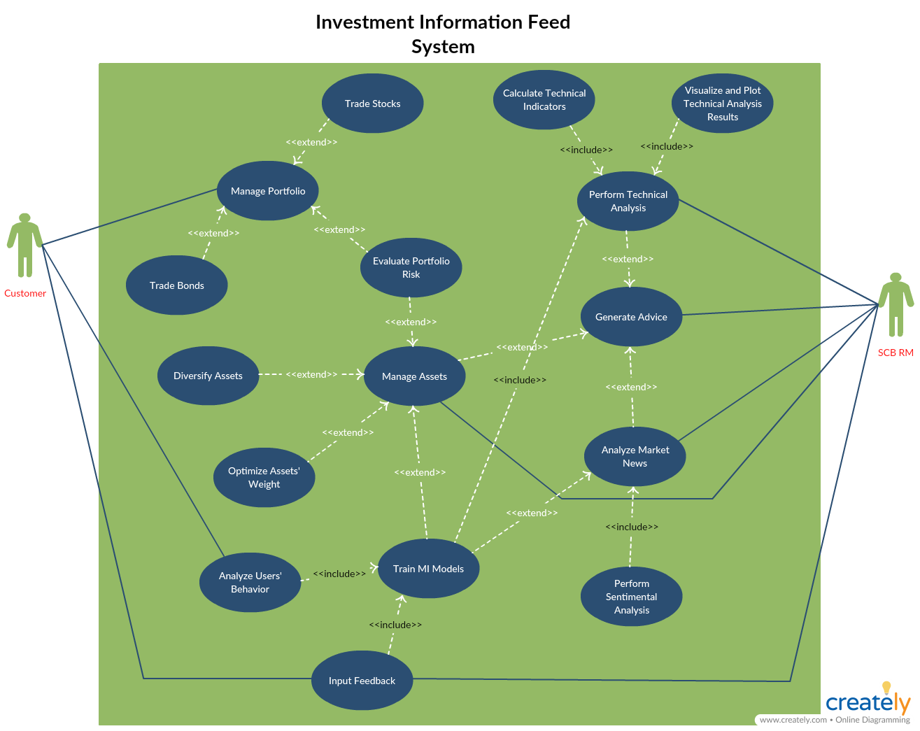
Use Case Diagram

Slide 4
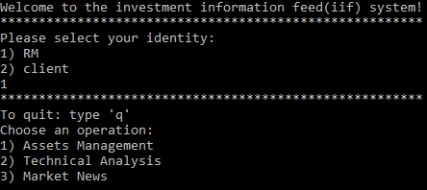
Methodology
Market News
Assets Management
Technical Analysis
Mainly encompass 3 parts
Machine learning and Deep learning

Slide 5

Technical Analysis

Slide 6
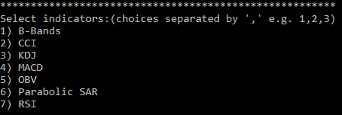
Provide a list of technical indicators for analysis
RM can analyze securities and/or the clients’ portfolios to generate investment advice
Feedback for training MI models
Technical Indicators Of AAPL | Client A | Client B
B-Bands | B | S
CCI | B | S
KDJ | S | S
MACD | B | B
OBV | S | S
RSI | B | B
Overall Advice | B | S
……
* B: Buy S: Sell
Training
More Accurate Investment Advice

Slide 7
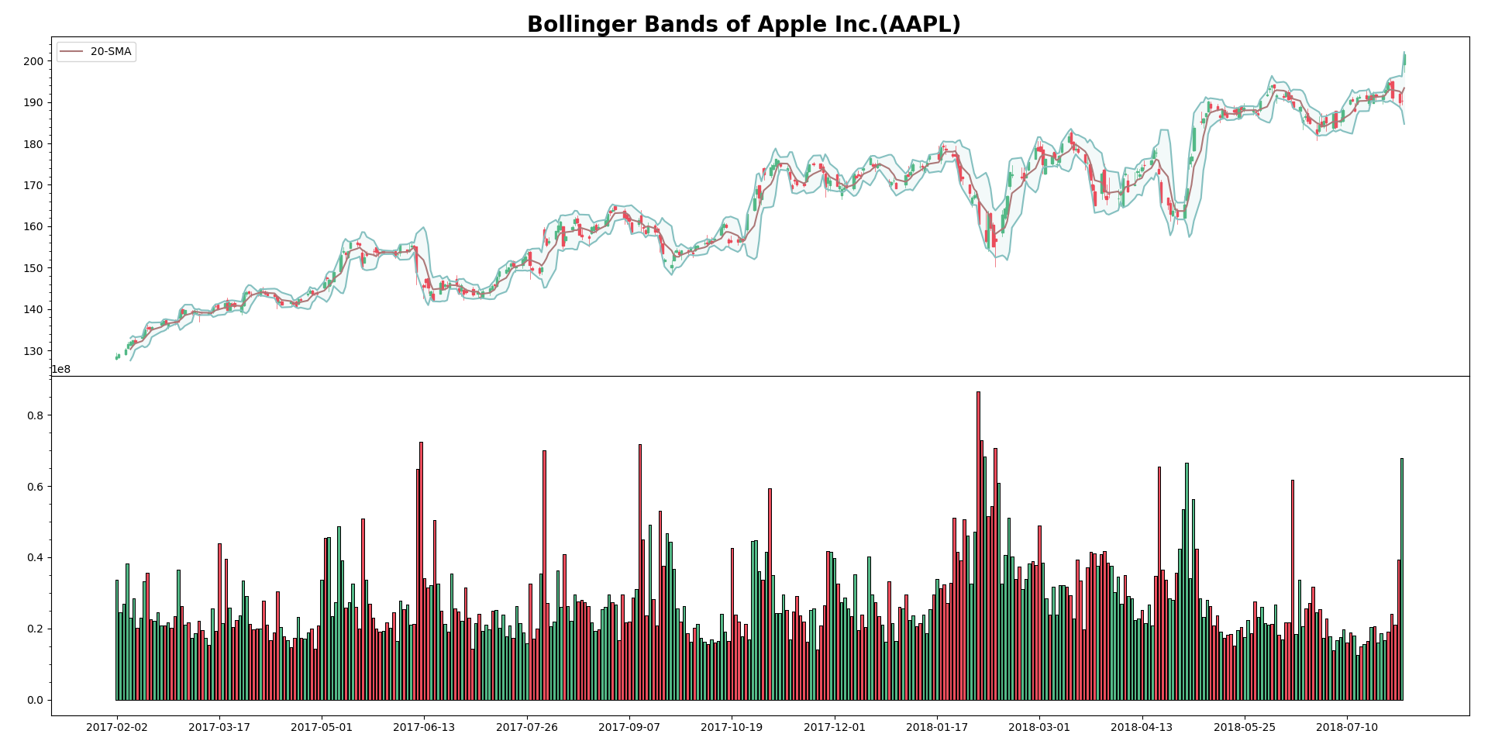
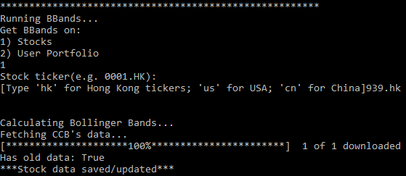
Bollinger Bands – BBands

Slide 8
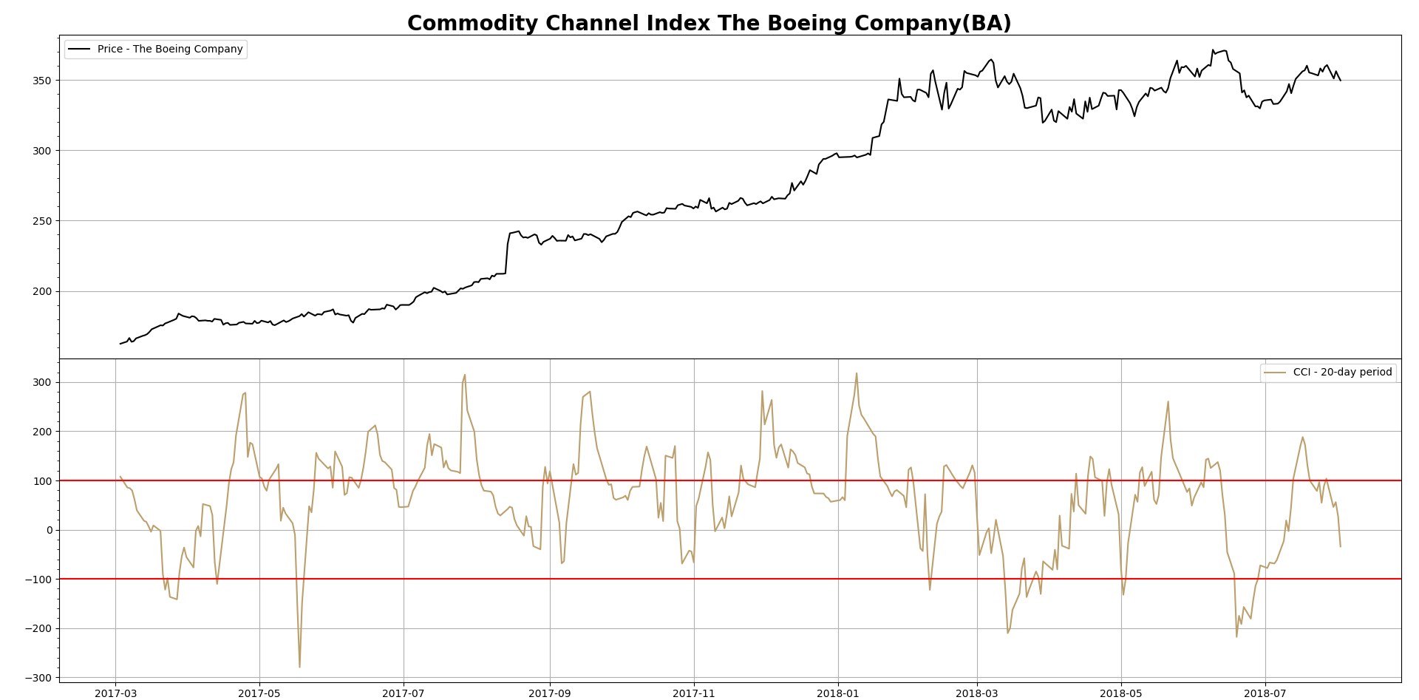
Commodity Channel Index - CCI

Slide 9
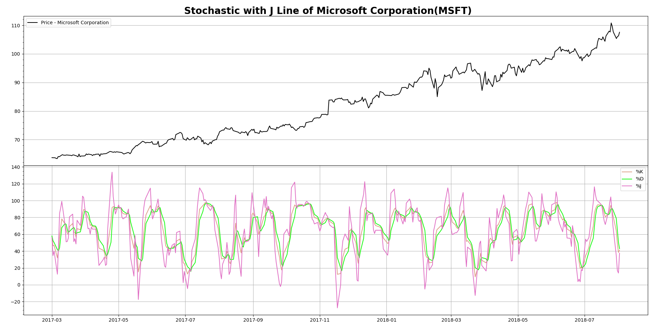
(Slow) Stochastic Oscillator with J Line - KDJ

Slide 10
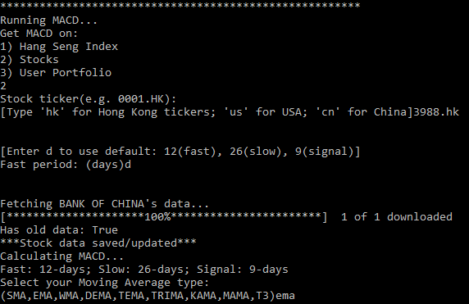
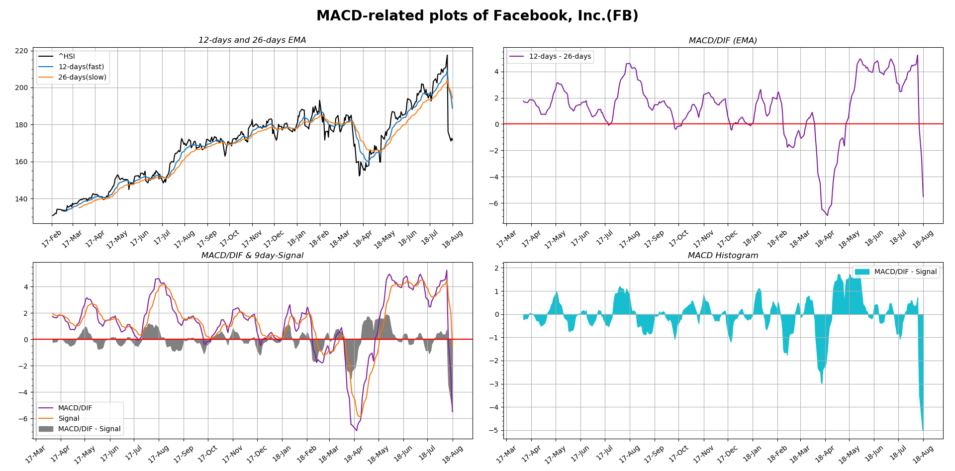
Moving Average Convergence/Divergence MACD

Slide 11
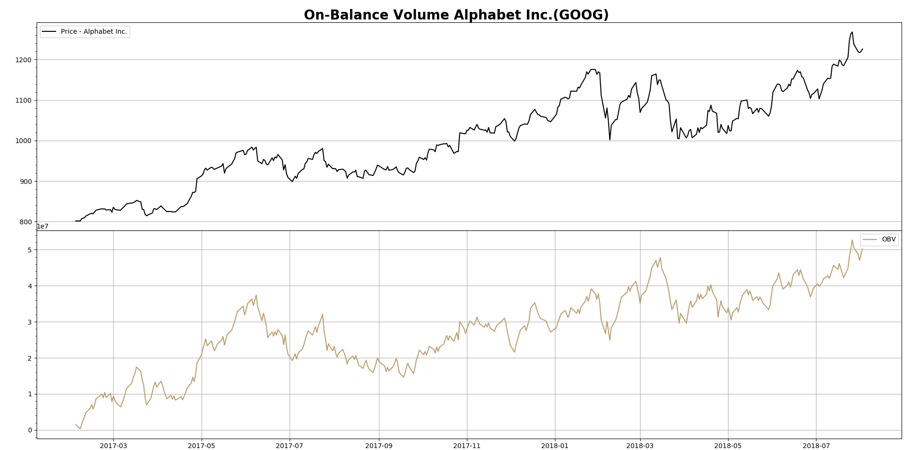
On Balance Volume - OBV

Slide 12
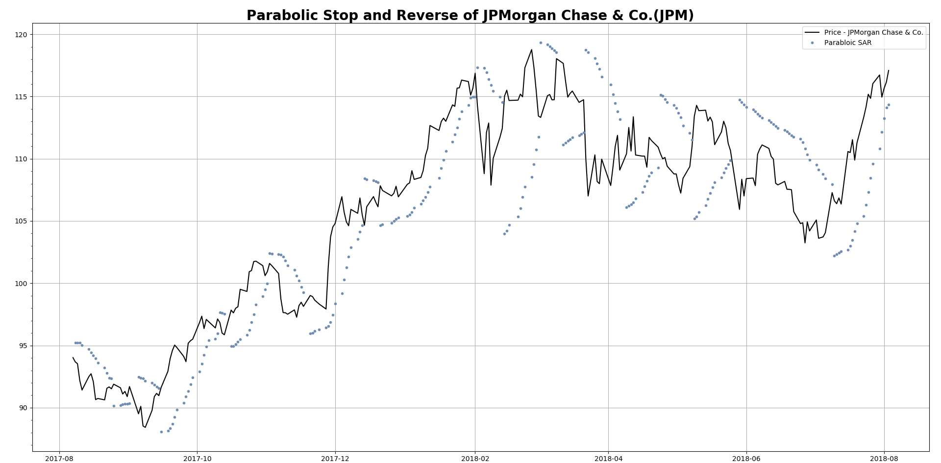
Parabolic Stop And Reverse - PSAR

Slide 13
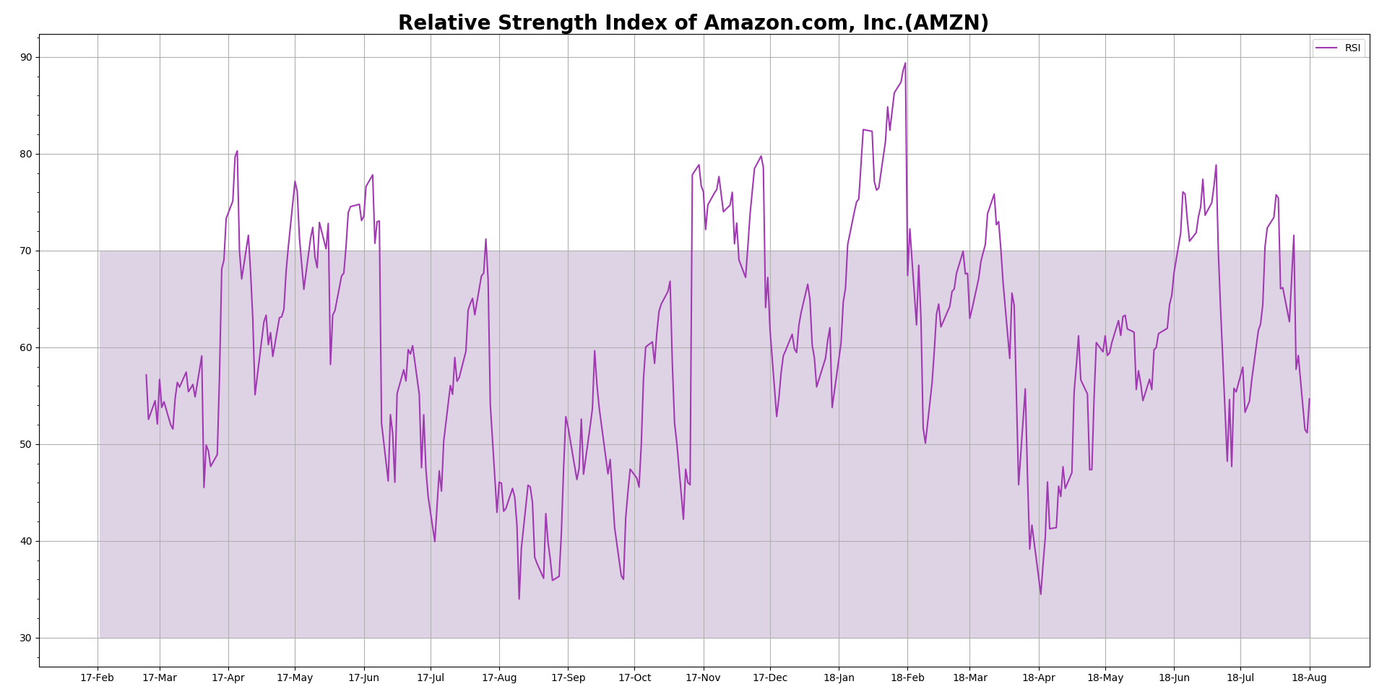
Relative Strength Index - RSI

Slide 14
Durable goods
Electronics
Healthcare
Foods
Consumer Goods and Services
Global Data
Research Network
Benchmarking
Brand intelligence
Trends
Industry and Technology Markets
Finance
B2B Services
Machinery
Media
Trade

